Slide 1
FAKE NEWS DETECTION USING NLP team Leader: ATTHILI SANTHOSHI Team Member KETHINENI BHAVYA VIGNAN’S INSTITUTE OF MANAGEMENT AND TECHNOLOGY FOR WOMEN (VMTW)

Slide 2
CONTEXT
ABSTRACT
INTRODUCTION
SYSTEM REQURIMENTS
LITERATURE REVIEW
EXISTING LIMITATION
PROPOSED SYSTEM
SYSTEM ARCHEITURE
MODELS
FURTURE SCOPE
IMPLEMENTATION
CONCLUSION
REFERENCES

Slide 3


Slide 4
ABSTRACT
In the age of digital media, fake news is a serious problem because it spreads misinformation and harms individuals, organizations, and even entire nations which is a challenging aspect. This study proposes a natural language processing approach for detecting fake news. In the proposed approach, a categorization model is developed with four different types of machine learning algorithms, evaluating the content and aesthetic components of news stories. The performance of the proposed model is analyzed by using a large dataset of real and fake news articles and the results show that it outperforms many existing systems. The proposed findings demonstrate the potential of machine learning techniques, such as logistic regression, decision tree, BERT, and passive aggressive algorithms to address the fake news detection challenges.

Slide 5
INTRODUCTION
The introduction of the internet and the rapid evolution of social media platforms such as Facebook and Twitter have outdated newspapers, magazines, articles etc which were the main source of valid information.
The social media platforms are extremely powerful in their current state are and known for their ability to allow users to discuss and share ideas.
But introduction of such platforms are also used in a negative way by certain people or organizations in the society commonly for monetary gain and in other cases for creating their own opinions, manipulating and misguiding peoples mindsets.
This process is generally what we call spreading fake news which can be really dangerous and
extremely harmful.

Slide 6

There have been a large number of reports everyday regarding fake news.
People should not forward any news which they get to others without knowing whether it is real or fake.
Basically when news is created all the information regarding author is also given, but in worst cases blind news gets forwarded hence we need to find and eradicate this from the starting stage itself.
Even general public has a major role in spreading of news be it fake or real.

Slide 7
Everyone relies on a variety of online resources for news. It changes the way people use information and news from traditional to digital, resulting in comfort and speed for both newsletters and news readers.
With so many social media platforms like Facebook, Twitter etc., news is spreading fast among millions of users because social media has made it easier to share information.
It makes it easy to access and share data and technology transformation. It is so easy to produce news in these forums that there may be false stories.
Fake news has become one of the main concerns as it can undermine governments that put modern society at risk.

Slide 8

SYSTEM REQURIMENTS SOFTWARE REQURIMENTS
Programming Language: Python is commonly used for NLP tasks due to it extensive libraries such as NLKT, scikit-learn for deep learning.
Development Environment : DEs like Jupyter Note book, Pycharm or Visual Studio code.
Database Management System (DBMS): Optional for storing large datasets efficiently.
Example: SQLite , MySQL or MongoDB.

Slide 9

HARDWARE REQURIMENTS
Sufficient resources(CPU/GPU) for training ,interface , depending on the size of the dataset and complexity of the model.
Storage space for storing datasets , trained models and intermediate results.

Slide 10

DATA REQURIMENTS
Access to labeled datasets containing both real and fake news articles.
Diverse sources to ensure the models’s robustness across different contexts.
Annotation guidelines for labeling news articles as real or fake.
Data preprocessing tools to clean and prepare the text data for analysis

Slide 11

NLP LIBRARIES AND TOOLS
NLTK (Natural Language Toolkit) or SpaCy for text preprocessing, tokenization, and lemmatization.
Scikit-learn for feature extraction, dimensionality reduction, and machine learning algorithms.
TensorFlow or PyTorch for building and training deep learning models.
Word embeddings (pre-trained or custom) for capturing semantic meanings of words.
Transformer architectures (BERT) for advanced language understanding.
Evaluation metrics libraries such as scikit-learn or TensorFlow/Keras metrics for assessing model performance

Slide 12
LITERATURE REVIEW
Uma Sharma The purpose of this paper is to give the user the ability to classify news as fake or real and to check the authenticity of the news publishing website. In this paper, four different machine learning algorithms such as Naïve Bayes, Random Forest and Logistic regression algorithms are used for classification. Dataset used in this paper LIAR: This database is compiled on the fact-checking website PolitiFact by its API.
Includes 12,836 brief statements from people.
Fake News Detection on Social Media
This paper focuses on fake news detection on social media platforms. It discusses the challenges of identifying fake news and proposes a framework that utilizes NLP techniques such as textual analysis and sentiment analysis to classify news articles as fake or real.

Slide 13
Detecting Fake News with Deep Learning” by Yang, K. et al. (2018) Linguistic Features for Fake News Detection
Yang et al. present a deep learning approach to detect fake news. Their model utilizes convolutional neural networks (CNNs) and long short-term memory networks (LSTMs) to capture semantic features from news articles and social media posts. NLP techniques are employed for text preprocessing and feature extraction.
Evidence from a Corpus of Fake News vs. Satire" by Rubin, V. L. et al. (2016)
This paper explores linguistic features that distinguish fake news from satire. It discusses linguistic cues such as sentiment, complexity, and lexical diversity, which are leveraged for fake news detection using NLP methods like machine learning classifiers.

Slide 14
EXISTING LIMITATION
Context Understanding:
NLP models often struggle with understanding context, sarcasm, irony, and other nuanced linguistic elements. Fake news can exploit these ambiguities to appear genuine
Data Quality and Quantity:
The effectiveness of NLP models heavily depends on the quality and quantity of training data. Gathering labeled datasets of fake news can be challenging due to its dynamic and subjective nature.
Language and Cultural Bias:
NLP models trained on certain languages or datasets may exhibit bias, leading to inaccuracies in fake news detection, especially in multilingual or culturally diverse contexts.

Slide 15
Source Dependence:
NLP-based fake news detection often relies on identifying unreliable sources. However, this can be challenging as the credibility of sources can vary based on context and may change over time.
Privacy Concerns:
Accessing and analyzing large amounts of data to train NLP models for fake news detection raises privacy concerns, especially when dealing with sensitive information or personal data.
User Behavior Analysis:
Fake news detection could benefit from considering user behavior and social network dynamics. However, collecting and analyzing such data raises privacy and ethical concerns, and it may not always be reliable

Slide 16
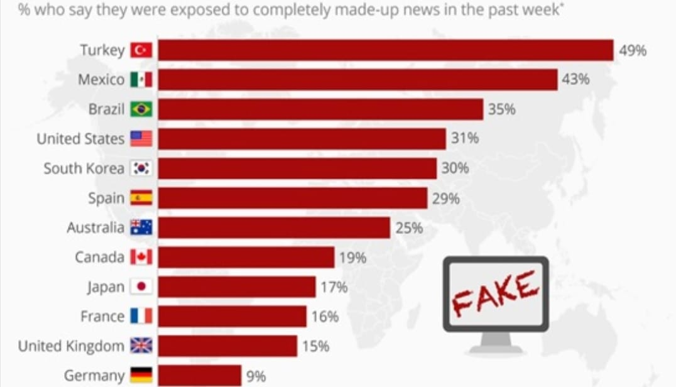
Where Exposure To Fake News Is Highest

Slide 17
PROPOSED SYSTEM
Our Proposed System is Natural Language processing.
Natural language processing is a form of Artificial Intelligence based on construction equipment that can easily understand and respond to text or voice data in the same way as humans.
With NLP, machines can even perform tasks with spoken or written text. Steps Involved in Natural Language processing are Data pre-processing, Tokenization, stemming, Lemmatization and vectorization.

Slide 18
Data pre-processing is the first and most important step in the development of machine learning models as it is concerned with preparing raw data and adapting the machine learning model.
The Natural Language Toolkit includes libraries for NLP activities such as stemming,lemmatization,stopwords(methods used to break sentences into tokens and word breaks)etc.

Slide 19
Lemmatization:
Lemmatization is a method used to reduce tokens to a standard form i.e., the form of a root dictionary. This process looks at morphological analysis of words to translate words into a common form.
Stemming:
Stemming is a form of reducing a word into its own vocabulary that is, the base of words. Stemming basically removes a suffix from a word and cuts it into its root. This process uses a noun stem.
Stopwords:
Stop words are used to remove non-essential words, allowing applications to focus on keywords instead.
Vectorization:
Vectorization jargon is an old method of converting input data from its raw format (i.e., text) into real number vectors which is a format supported by ML models. This approach has been around since the advent of computers, works wonders in a variety of domains, and is now widely used in NLP. We have TF-IDF

Slide 20
TF-IDF: TF stands for Term Frequency. It can be understood as a general effect of frequency. IDF stands for Inverse Document Frequency, but before we go into IDF, we have to make sense of DF - Document Frequency

Slide 21
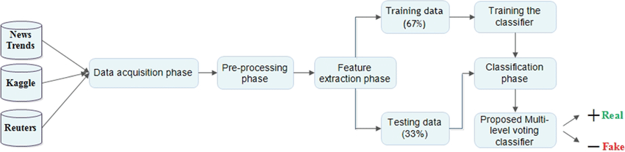
SYSTEM ARCHEITURE
Fig1: Architecture of the proposed automatic fake news detection system

Slide 22
DATA COLLECTION
The first step involves gathering a large dataset of news articles or content. This dataset should ideally include both real and fake news articles to train the model effectively
PREPROCESSING
Before feeding the data into the NLP model, preprocessing is done to clean the text and prepare it for analysis. This includes tasks such as tokenization, lowercasing, removing punctuation, stop words, and special characters, as well as stemming or lemmatization.
FEATURE EXTRACTION:
In this step, features are extracted from the preprocessed text data. These features could include word frequency, n-grams, syntactic features, semantic features, and other linguistic features that help the model understand the content of the text.
MODEL BUILIDING
Various machine learning or deep learning models are employed to classify news articles as real or fake based on the extracted features. Common approaches include
SUPERVISED LEARNING
Using algorithms like Support Vector Machines (SVM), Random Forest, Naive Bayes, or Logistic Regression trained on labeled data.

Slide 23
MACHINE LEARNING MODELS
Machine learning models are used to predict the correct label for the given test data. So, supervised learning algorithms such as Passive Aggressive Classfication(PAC) and SVM algorithms.
Passive-Aggressive algorithms are a family of Machine learning algorithms that are popularly used in big data application. Passive-Aggressive algorithms are generally used for large-scale learning. It is one of the online-learning algorithms. In online machine learning algorithms, the input data comes in sequential order and the machine learning model is updated sequentially, as opposed to conventional batch learning, where the entire training dataset is used at once.
This is very useful in situations where there is a huge amount of data, and it is computationally infeasible to train the entire dataset because of the sheer size of the data.

Slide 24
DATA ANALYSIS
Here I will explain the dataset.
In this python project, we have used the CSV dataset. The dataset contains 57796 rows and 4 columns.
This dataset has four columns,
title: this represents the title of the news.
author: this represents the name of the author who has written the news.
text: this column has the news itself.
label: this is a binary column representing if the news is fake or real

Slide 25
# PASSIVE-AGGRESSIVE CLASSIFIER
from sklearn.metrics import accuracy_scorefrom sklearn.linear_model import PassiveAggressiveClassifier pac=PassiveAggressiveClassifier(max_iter=50) pac.fit(x_train,y_train) #Predict on the test set and calculate accuracyy_pred=pac.predict(x_test)score=accuracy_score(y_test,y_pred) print(f'Accuracy: {round(score*100,2)}%') Output:
Accuracy: 93.12%

Slide 26
OUTPUT OF THE MODELS

Slide 27
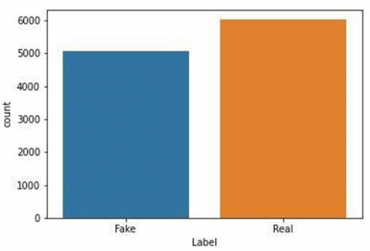
FUTURE SCOPE
Natural Language Processing(NLP) : Integrating NLP techniques can enhance the accuracy of the system in detecting fake news ,by analyzing the sentiment and one of the news article.
Incorporating multimedia content : The system can be further improved by incorporating multimedia content such as images and videos,to detect fake news that are propagated through such means.
Mobile Application:Developing a mobile application for the system can make it more accessible to users on-to-go,thus enhancing its usability and user engagement.
These are just a few of the potential areas for future development and improvement of the Fake News Detection System using Multinomial.

Slide 28
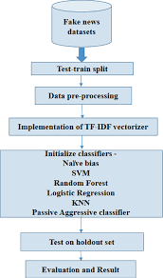
I IMPLEMENTATION

Slide 29

CONCLUSION
The passive-aggressive classifier performed the best here and gave an accuracy of 93.12%....
We can print a confusion matrix to gain insight into the number of false and true negatives and positives.
Fake news detection techniques can be divided into those based on style and those based on content, or fact-checking. Too often it is assumed that bad style (bad spelling, bad punctuation, limited vocabulary, using terms of abuse, ungrammaticality, etc.) is a safe indicator of fake news.
More than ever, this is a case where the machine’s opinion must be backed up by clear and fully verifiable indications for the basis of its decision, in terms of the facts checked and the authority by which the truth of each fact was determined.

